Slide 1
Cheerboxite
Team members : Bhagya pillai 338
sakshee kolhe 317
manthan choudary 321

Slide 2
CheerBoxite
In beginning, robots were only used for a singular function or purpose that is as an aid to human in industrial applications.
Nowadays, the robot is not only assigned to do work but also for entertainment purpose.
As a part of it, dancing robots can be created. Dancing robots grab the attention of people with their ability to dance on the floor especially on their own feet. Their smooth movement while dancing, captures everyone's heart. This may increase the interest of people in robotic world.

Slide 3
Abstract
Dance as a form of performing arts includes a wide range of social behavior's, is an important means of communication, is a useful tool for psychological and physical therapy and is a natural means of emotional expression. Robotic dance has attracted interest in the field of social robotics, and dancing robots can perform many kinds of robotic dances.
In general, robotic dance has many social effects in society:
1) It is a kind of interactive social behavior, in particular human–robot interaction and animal activity, 2) it is a way to express the emotions or intentions of robots through nonverbal communication, 3) it is a treatment and therapy for a wide range of illnesses, including autism, developmental disorders, and attention deficit and cognitive disabilities. Dancing robots involve the exploration of the physical hardware structures, kinematics, dynamics, and the automation of a robot so it can dance. On the other hand, robotic dance is an expressive form of the art of dance performed by robots and is focused on how to make a robot dance as a human does, and how a robot creates and performs beautiful dance. In addition to these a hand gesture recognition system that allows interaction with robot in dynamic environment and in real-time is purpose the system detects hand and static gestures and moves accordingly

Slide 4
Problem Statement
Several hand detection and hand gesture recognition systems have been proposed. Early systems usually require markers or coloured gloves to make the recognition easier. Second generation methods use low-level features as color (skin detection), shape or depth information for detecting the hands.
However, those systems are not robust enough for dealing with dynamic conditions; they usually require uniform background, uniform illumination, a single person in the camera view, and/or a single, large and centered hand in the camera view. But in our proposed model (Cheerleader) should dance, move freely and performs dance on the music.
Dancing robot should grab the attention of people with their ability to dance and aesthetics should detect hand and static gestures in dynamic environment and in real-time. According given hand input robot should speak and move accordingly

Slide 5
Objective
To design dancing robot that will dance according to the programmed movement along with the chosen music within a specific time frame.
To static and dynamic hand gesture in real time.
To move the robot according to the given hand gesture.
To write a program so that robot will change volume according to hand gesture

Slide 6
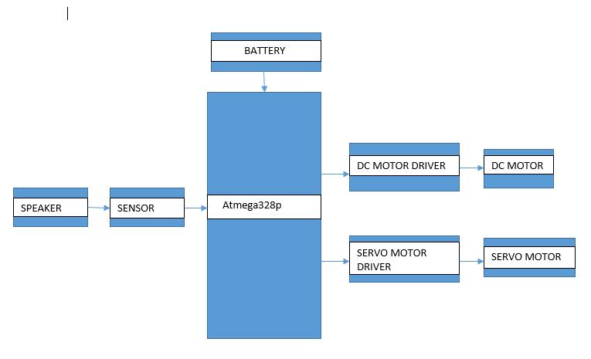
Block diagram

Slide 7
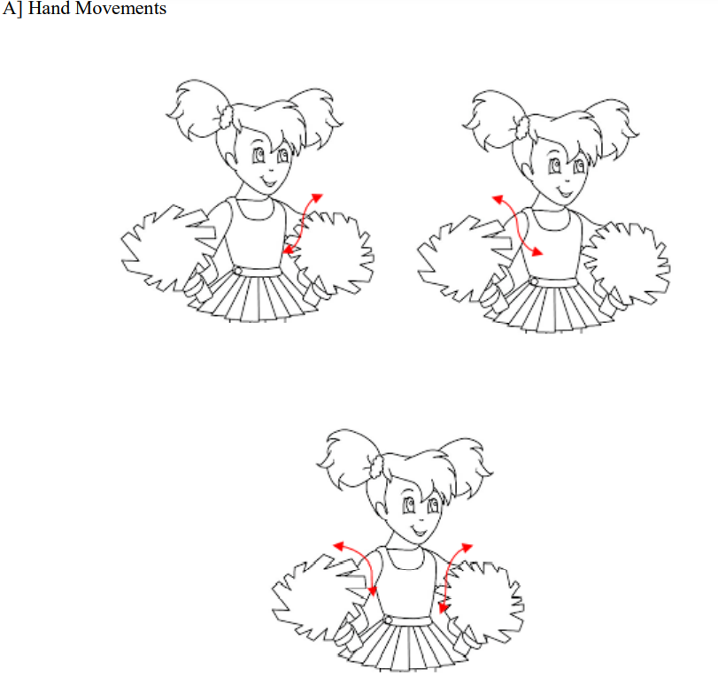
Moments

Slide 8
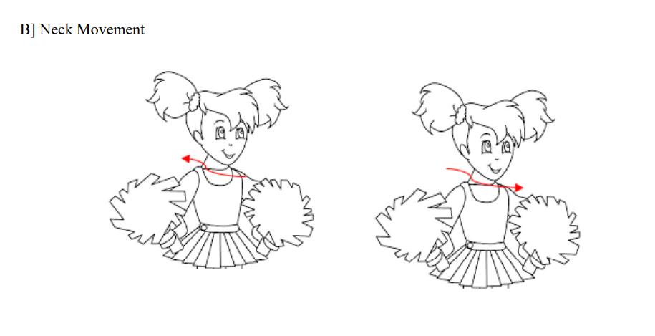

Slide 9
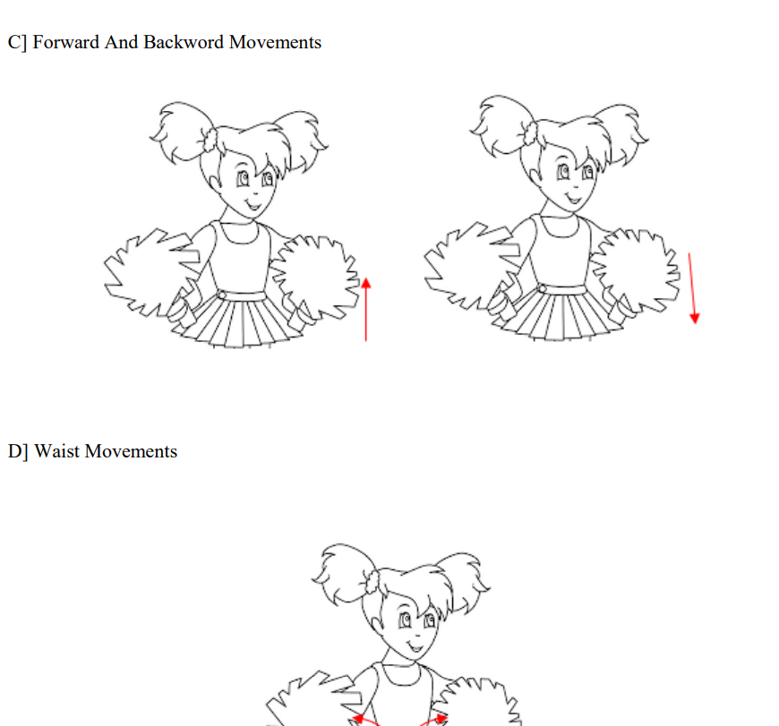

Slide 10
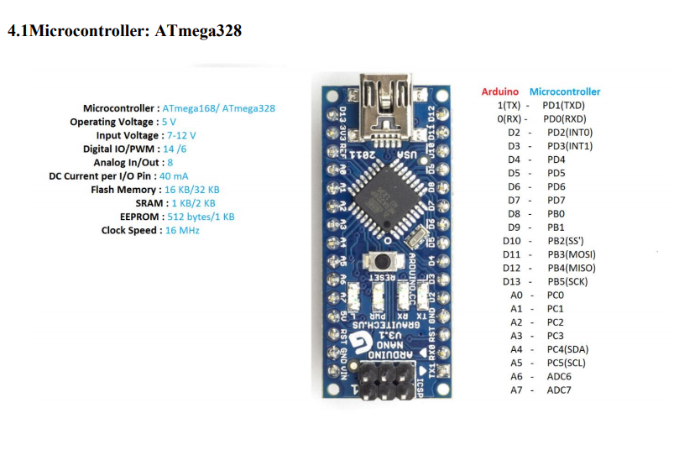
specification

Slide 11
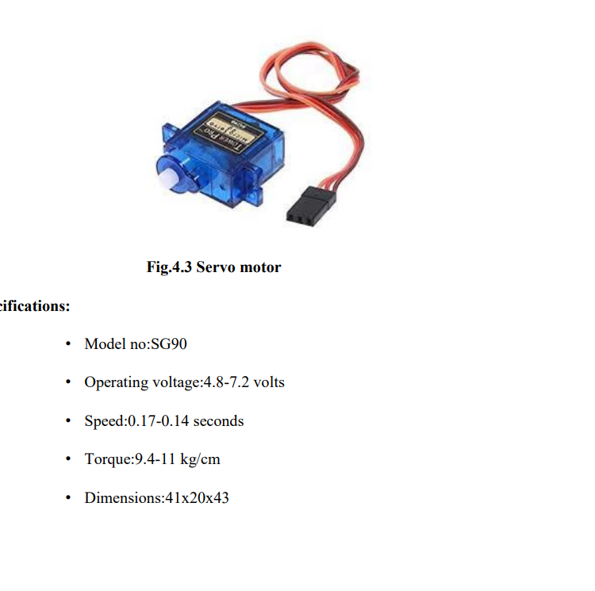
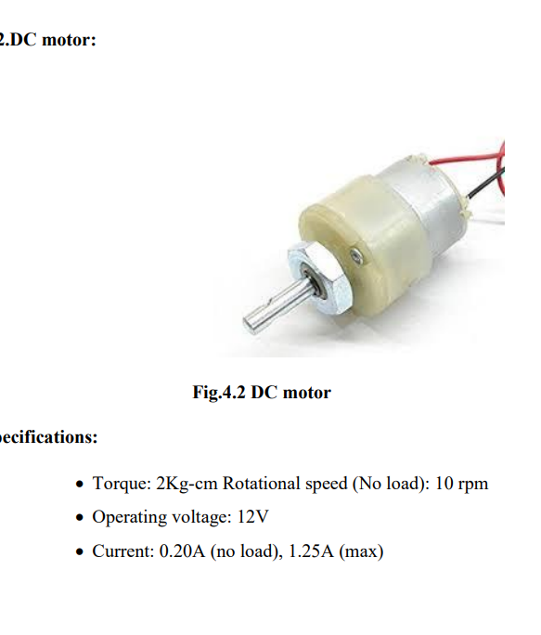
dc

Slide 12
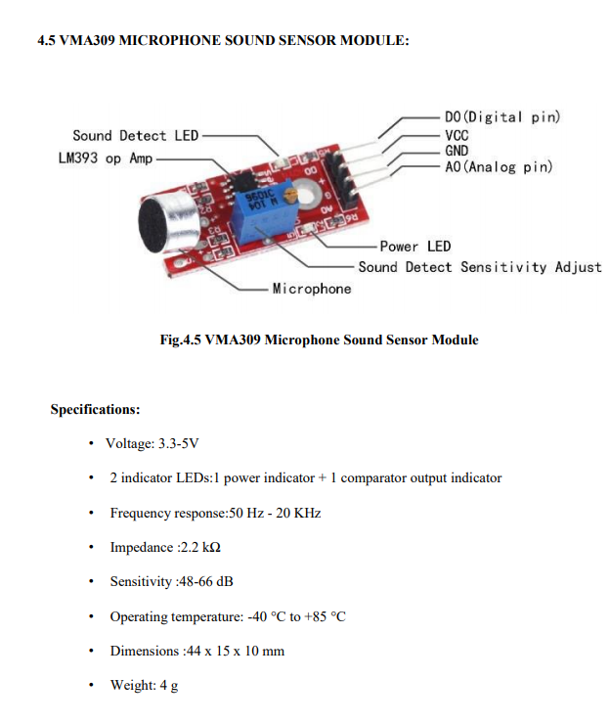
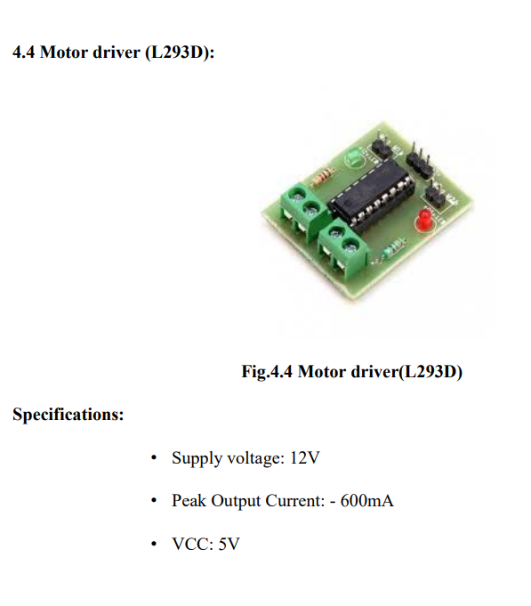

Slide 13
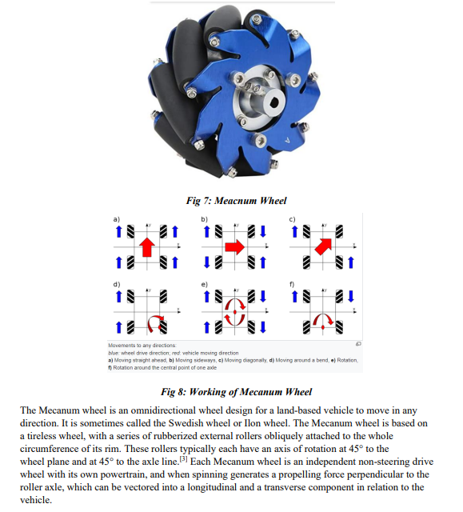
Mecanum Wheel :

Slide 14
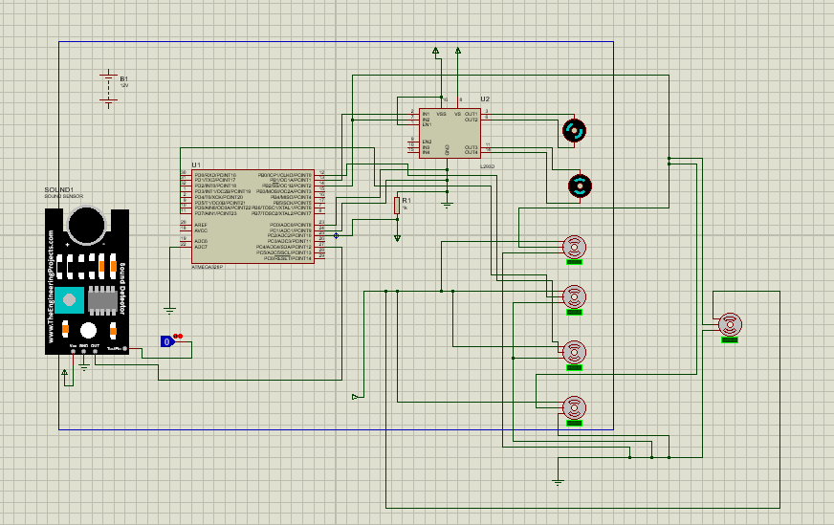
Results

Slide 15
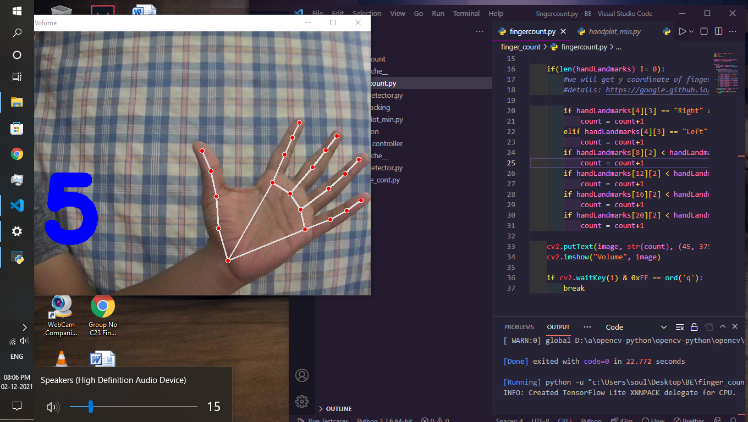
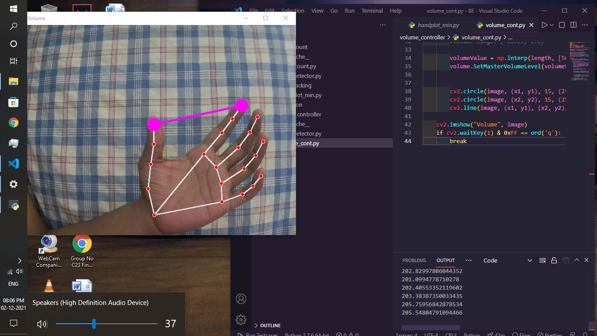
Stimulation result

Slide 16
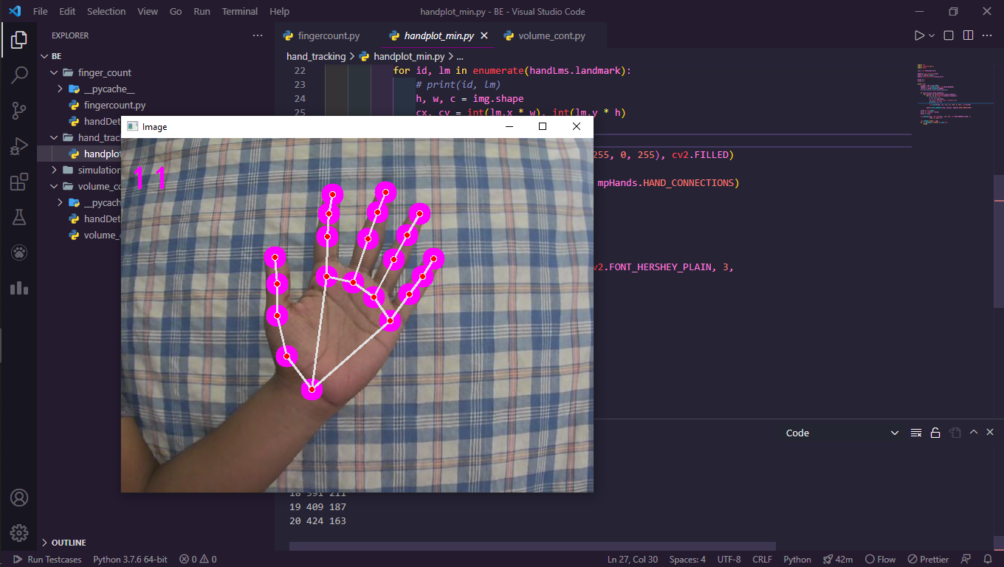
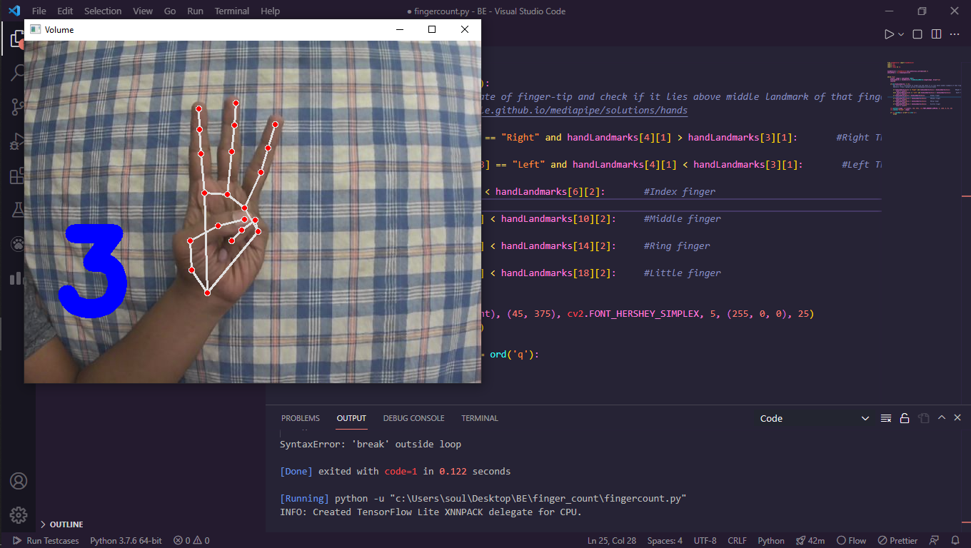

Slide 17
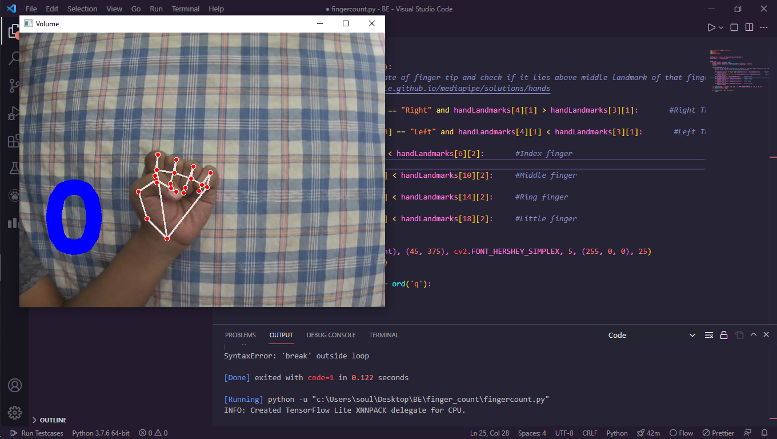
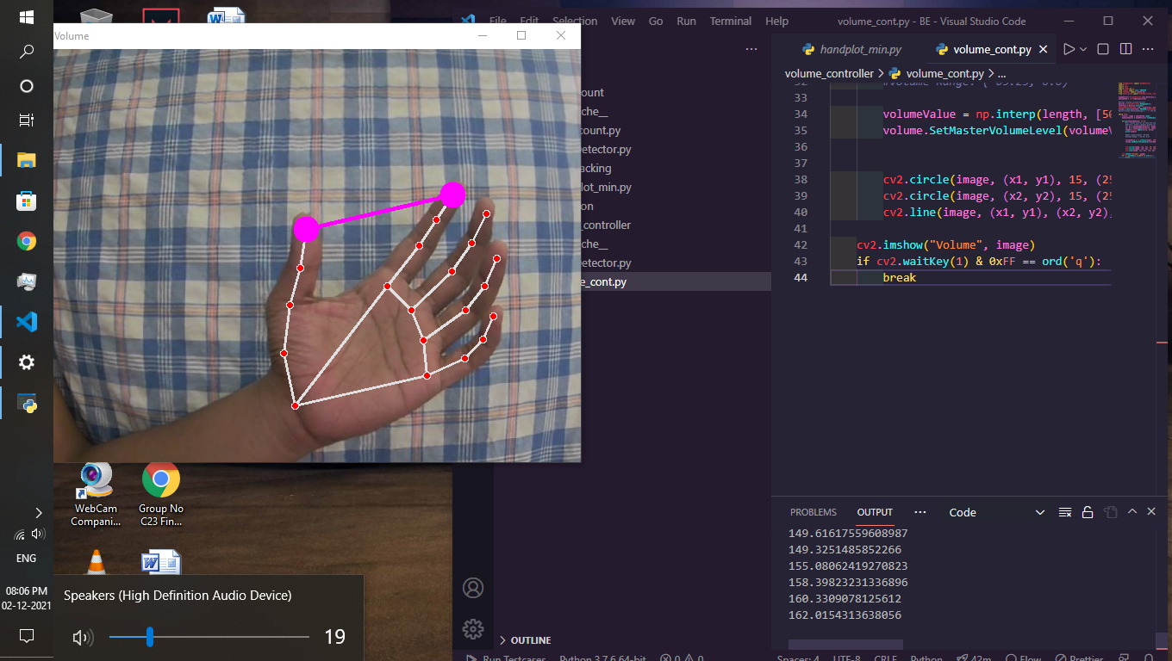

Slide 18
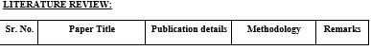
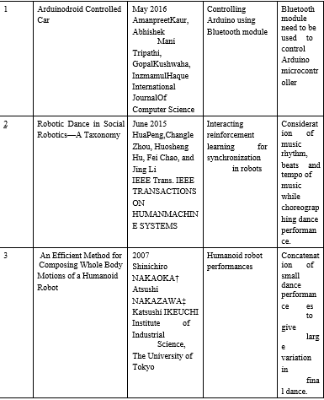
Literature review

Slide 19
literature Survey
During literature review, we came across various journals, conference papers, articles and Newsletters. The details of literature survey are given below: Going through different articles and journal papers intrigued the team to analyse how we can build human interactive robot. In Arduino Controlled Car Bluetooth module were used to control Arduino microcontroller and hence car was controlled by using Arduino and Bluetooth. In Robotic Dance in Social Robotics—A Taxonomy research paper, researchers have divided robotic dance into several categories and explained each of them very well. Categories are as follows:1. cooperative human robot dance
2. Imitation of human dance
3. Synchronization of music and
4.Robotic choreography. In that we have studied synchronization and choreography part but given paper is not sufficient for physical structure, hardware of dancing robot and a robot to synchronize its dance to various music types harmoniously as a human does. In An Efficient Method for Composing Whole Body Motions of a Humanoid Robot we investigated an approach of Concatenating small dance performances to give large variation in final dance. In The design of face recognition and tracking for human-robot interaction paper we studied about how Python 2.7 (with the OpenCV library) by using Cascade Classification and LBPH Face Recognizer method can be used and which has a good accuracy rate (92.73%). Also, the implementation of facial tracking to control 12 DoF of Social Robot SyPEHULbased on Arduino microcontroller. For detecting human hand we can use various different tools and algorithms. After going through various research papers we have decided to use Python and OpenCV library to detect human hand in dynamic and run time environment

Slide 20
Expected conclusion
Cheerleader should move synchronously.
Should move freely and perform dance on the music.
It should grab the attention of people and kids with their aesthetics and dancing ability. This is autonomous system.
• Robot should dance according to the programmed movement along with the chosen music within a specific time frame.
• Robot should be able to recognise static and dynamic hand gesture in real time. • Robot should move according to the given hand gesture.

Slide 21
Applications
It can be used in schools for motivating kids to develop their motor skills.
It can be used in homes that would help the parents to engage their kids in entertainment with exercise.
It can be also used in smart malls for costumer attraction.
It can be used in television shows too.

Slide 22
Advantages.
Cheerboxite can be used for enhancing the motor skills in kids mind.
It can be used to increase creativity in young minds.
We can use this bot for increasing the awareness need of exercise in our day to day life by adding additional AI features.
It motivates the child to dance with it and enjoy their time of playing in a enthusiastic way.

Slide 23
References
[1] Hua Peng, Changle Zhou, Huosheng Hu, Fei Chao, and Jing Li,” Robotic Dance in Social Robotics—A Taxonomy” IEEE Trans. IEEE TRANSACTIONS ON HUMAN-MACHINE SYSTEMS, VOL. 45, NO. 3, JUNE 2015
[2] D. O’Halloran, A. Wolf, Member, IEEE, H. Choset, Member, IEEE,” Design of a High-Impact Survivable Robot” Proceeding of the 2004 IEEE, Internatonal Conference on Robotics & Automation, New Orleans, LA. April 2004 • Books: Beginning C for Arduino Second Edition-Jack Purdum,Ph.D • Related Si
[3] M. S. Kalas, “Real Time Face Detection and Tracking Using OpenCV,”International Journal of Soft Computing and Artificial Intelligence,vol. 2, no. 1, pp. 41–44, 2014
[4] C. Zhan, W. Li, P. Ogunbona, and F. Safaei, “A Real-Time Facial Ex-pression Recognition System for Online Games,” International Journalof Computer Games Technology, vol. 2008, pp. 1– 7, 2008
[5] Q. Chen, N.D. Georganas, E.M. Petriu, Real-time Vision-based Hand Gesture RecognitionUsing Haar-like Features, Proc. Instrumentation and Measurement Technology Conf. –IMTC 2007, (2007)Warsaw, Poland
[6] J. Ruiz-del-Solar, and R. Verschae, Skin Detection using Neighborhood Information. 6thInt. Conf. on Face and Gesture Recognition – FG 2004, pp. 463 – 468, Seoul, Korea, May2004

Slide 24


